Slide 1
Exploring NLSY97 religiosity data with ISEC-ML
Andrey Koval
Nov 26th, 2012

Slide 2
Project Goals
Multilevel analysis of NLSY97 religious attendance data
How does religiosity change with time?
Present a prototype of interface for specifying, evaluating, and communicating multilevel models (ISEC-ML)
Popularize reproducible research and multilingual estimation

Slide 3
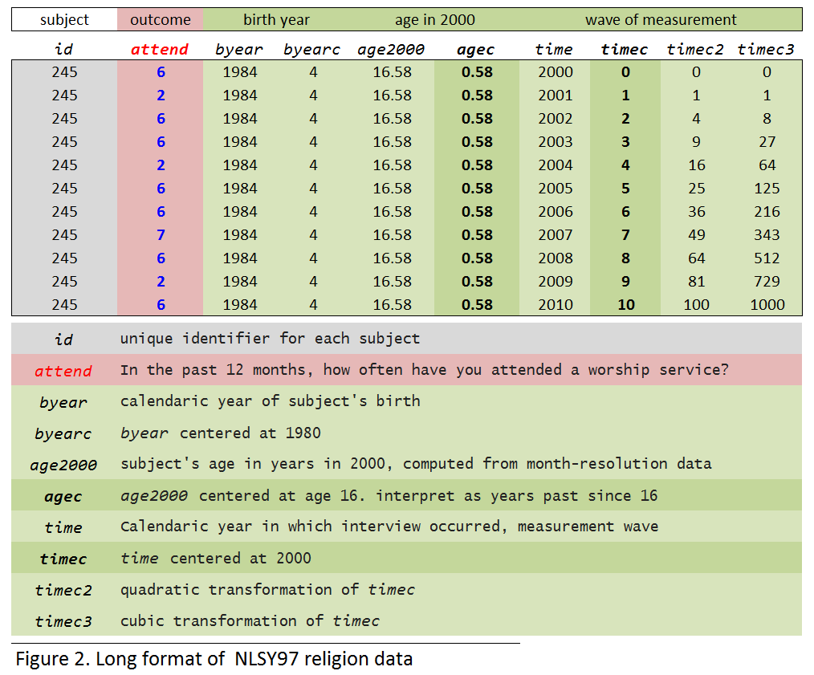
N = 4,928
National Longitudinal Study of Youth
NLSY97
Everyday |8
>1/week|7
~ 1/week |6
~ 2/month |5
~ 1/month |4
< 1/month |3
Once -Twice |2
Never |1
Notes:
The slide to duscuss data structure and variable definition

Slide 4
wave of measurement, centered at 2000 - timec
age in years in 2000, centered at 16 - agec
Worship Attendance Scale |
Everyday |8
>1/week|7
~ 1/week |6
~ 2/month |5
~ 1/month |4
< 1/month |3
Once -Twice |2
Never |1
m00 <-lm (attend ~ 1 ) +
timec + agec:timec +
timec2 + agec:timec2 +
timec3 + agec:timec3 +
(1 + timec + timec2+ timec3 | id))
MIXED attend WITH timec timec2 timec3 agec
/FIXED= INTERCEPT timec timec2 timec3
agec*timec agec*timec2 agec*timec3
/Random= INTERCEPT timec timec2 timec3 | SUBJECT(ID) COVTYP(UN)
Notes:
To model is to express or specify the structure of the relationship among data.
ANOTH way to think about models is a set of instructions on what to do to data.
So we take our outcome and model it – express it’s relationship to predictors. We’ll do it in 4 distinct ways (point to four predictors on slide)

Slide 5
Output
Fit surface
Graphs
wave of measurement, centered at 2000 - timec
age in years in 2000, centered at 16 - agec
Worship Attendance Scale |
Everyday |8
>1/week|7
~ 1/week |6
~ 2/month |5
~ 1/month |4
< 1/month |3
Once -Twice |2
Never |1
m00 <-lm (attend ~ 1 ) +
timec + agec:timec +
timec2 + agec:timec2 +
timec3 + agec:timec3 +
(1 + timec + timec2+ timec3 | id))
R subtitles
MIXED attend WITH timec timec2 timec3 agec
/FIXED= INTERCEPT timec timec2 timec3
agec*timec agec*timec2 agec*timec3
/Random= INTERCEPT timec timec2 timec3 | SUBJECT(ID) COVTYP(UN)
SPSS subtitles
Specification
Estimation
Specification
mNumber
Notes:
These two ( shaded areas) would specify our model structurally. Top box would contain traditional notation, while the bottom box would hold the notation that I have modified to better connect it with other section of the interface.
These two ( point to subtitles) would translate the implication from the structure of the model into two command languages: SPSS, that we have been using all semester, and lmer , a package for multilevel/mixed modeling in R.
In the negative space in lower right we’ll put the results of the estimation, while the larger spandrel on the left would host a multipurpose area to show Output files, explore the fit surface, and graphs.

Slide 6
Output
Fit surface
Graphs
Legend
R subtitles
SPSS subtitles
Specification
Estimation
Specification
Notes:
This what our interface would like

Slide 7
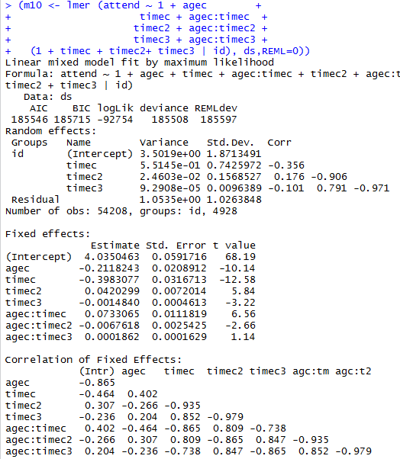
wave of measurement, centered at 2000 - timec
age in years in 2000, centered at 16 - agec
Example
Worship Attendance Scale |
Everyday |8
>1/week|7
~ 1/week |6
~ 2/month |5
~ 1/month |4
< 1/month |3
Once -Twice |2
Never |1
m10 <-lmer (attend ~ 1 + agec +
timec + agec:timec +
timec2 + agec:timec2 +
timec3 + agec:timec3 +
(1 + timec + timec2+ timec3 | id))
MIXED attend WITH timec timec2 timec3 agec
/FIXED= INTERCEPT timec timec2 timec3
agec agec*timec agec*timec2 agec*timec3
/Random= INTERCEPT timec timec2 timec3 | SUBJECT(ID) COVTYP(UN)
SD / corr
SD
Notes:
Why do we need such interface?
Because when we want to put in the same screen all we need to keep in mind to evaluate a model, we need a lot of information.
This is the most complex model we will fit. It looks like a crowded slide, but it really its.

Slide 8
wave of measurement, centered at 2000 - timec
age in years in 2000, centered at 16 - agec
Worship Attendance Scale |0
Everyday |8
>1/week|7
~ 1/week |6
~ 2/month |5
~ 1/month |4
< 1/month |3
Once -Twice |2
Never |1
m10 <-lmer (attend ~ 1 + agec +
timec + agec:timec +
timec2 + agec:timec2 +
timec3 + agec:timec3 +
(1 + timec + timec2+ timec3 | id))
MIXED attend WITH timec timec2 timec3 agec
/FIXED= INTERCEPT timec timec2 timec3
agec agec*timec agec*timec2 agec*timec3
/Random= INTERCEPT timec timec2 timec3 | SUBJECT(ID) COVTYP(UN)
SD / corr
SD
Notes:
This is a start for tear-down modeling strategy

Slide 9
N = 4,928
National Longitudinal Study of Youth
Everyday |8
>1/week|7
~ 1/week |6
~ 2/month |5
~ 1/month |4
< 1/month |3
Once -Twice |2
Never |1
0
1
2
3
4
5
6
7
8
9
10
11
12
Notes:
The slide to duscuss data structure and variable definition

Slide 10
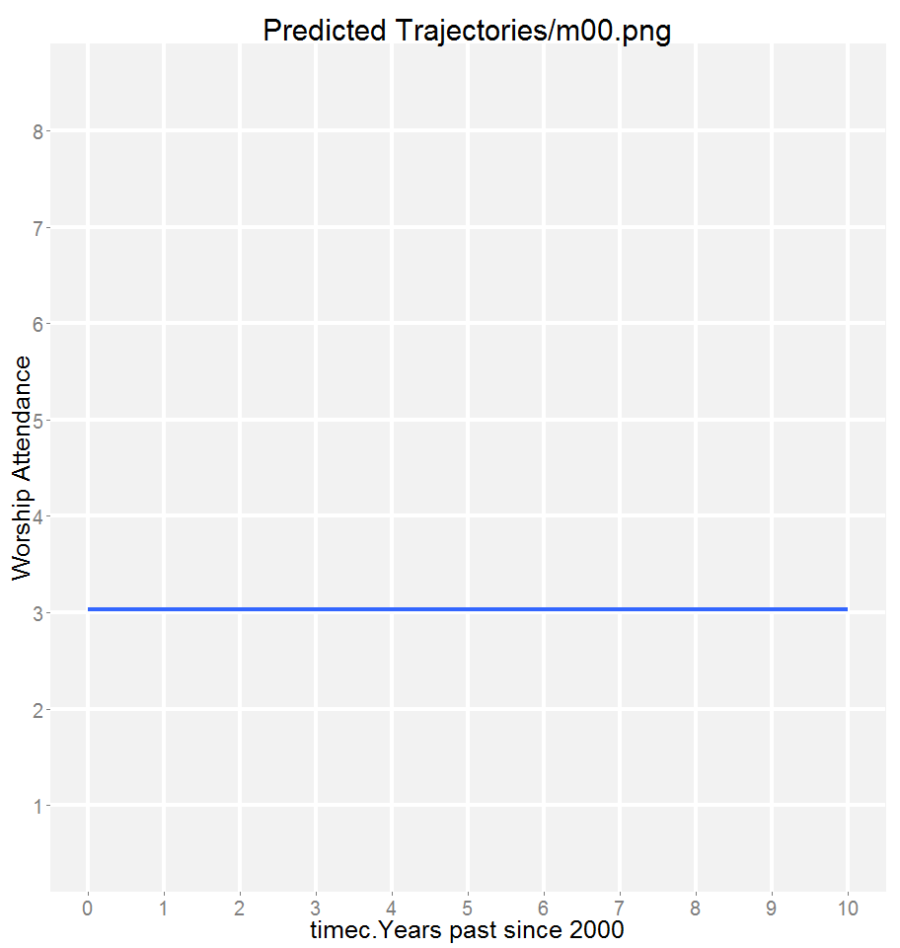
wave of measurement, centered at 2000 - timec
age in years in 2000, centered at 16 - agec
Graph
Fit
Output
Worship Attendance Scale |0
Everyday |8
>1/week|7
~ 1/week |6
~ 2/month |5
~ 1/month |4
< 1/month |3
Once -Twice |2
Never |1
(m00 <-lm (attend ~ 1),
data = ds, REML=0))
MIXED attend WITH timec timec2 timec3 agec
/FIXED= INTERCEPT timec timec2 timec3
agec*timec agec*timec2 agec*timec3
/Random= INTERCEPT timec timec2 timec3 | SUBJECT(ID) COVTYP(UN)
SD / corr
SD
m00
0
1
2
3
4
5
6
7
8
9
10
11
12
Notes:
But we will use building-up strategy instead. IMHO, it makes more sense to increase complexity gradually when first learning about data.
Between years 2000 and 2001 , people who in 2000 were between 16 and 20 years of age, attended worship service less than once a month (3.031) on average.
In other words, subjects were scoring a 3.031 on the NLSY97 worship attendance scale.

Slide 11
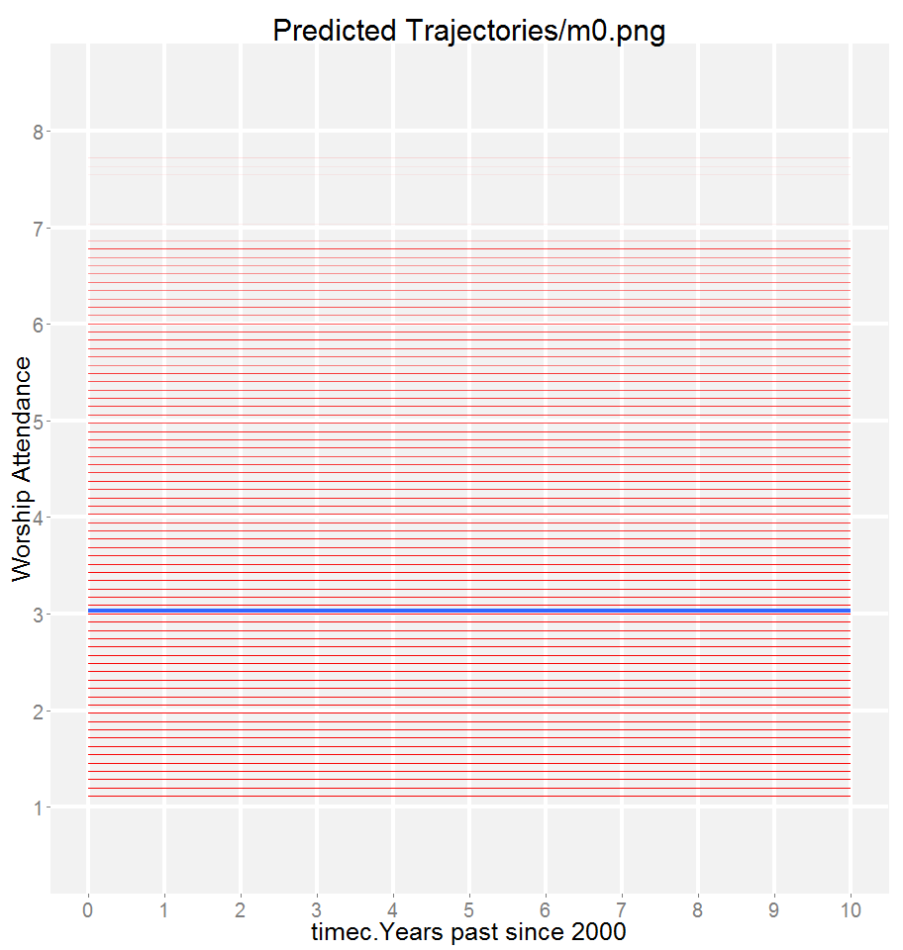
wave of measurement, centered at 2000 - timec
age in years in 2000, centered at 16 - agec
Graph
Fit
Output
Worship Attendance Scale |0
Everyday |8
>1/week|7
~ 1/week |6
~ 2/month |5
~ 1/month |4
< 1/month |3
Once -Twice |2
Never |1
(m0 <-lmer (attend ~
1 + (1 | id),
data = ds, REML=0))
MIXED attend WITH timec timec2 timec3 agec
/FIXED= INTERCEPT timec timec2 timec3
agec*timec agec*timec2 agec*timec3
/Random= INTERCEPT timec timec2 timec3 | SUBJECT(ID) COVTYP(UN)
SD / corr
SD
m0
0
1
2
3
4
5
6
7
8
9
10
11
12

Slide 12
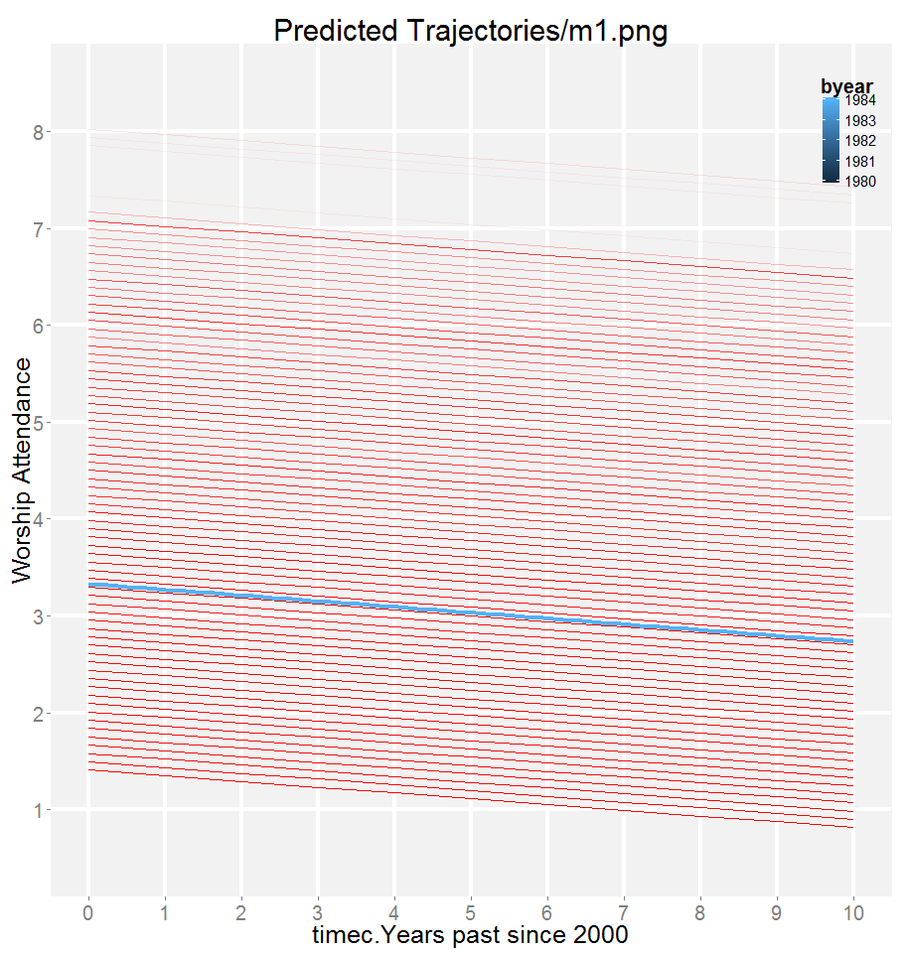
wave of measurement, centered at 2000 - timec
age in years in 2000, centered at 16 - agec
Graph
Fit
Output
Worship Attendance Scale |0
Everyday |8
>1/week|7
~ 1/week |6
~ 2/month |5
~ 1/month |4
< 1/month |3
Once -Twice |2
Never |1
(m1 <-lmer (attend ~
1 + timec
+ (1 | id),
data = ds, REML=0))
MIXED attend WITH timec timec2 timec3 agec
/FIXED= INTERCEPT timec timec2 timec3
agec*timec agec*timec2 agec*timec3
/Random= INTERCEPT timec timec2 timec3 | SUBJECT(ID) COVTYP(UN)
SD / corr
SD
m1
0
1
2
3
4
5
6
7
8
9
10
11
12

Slide 13
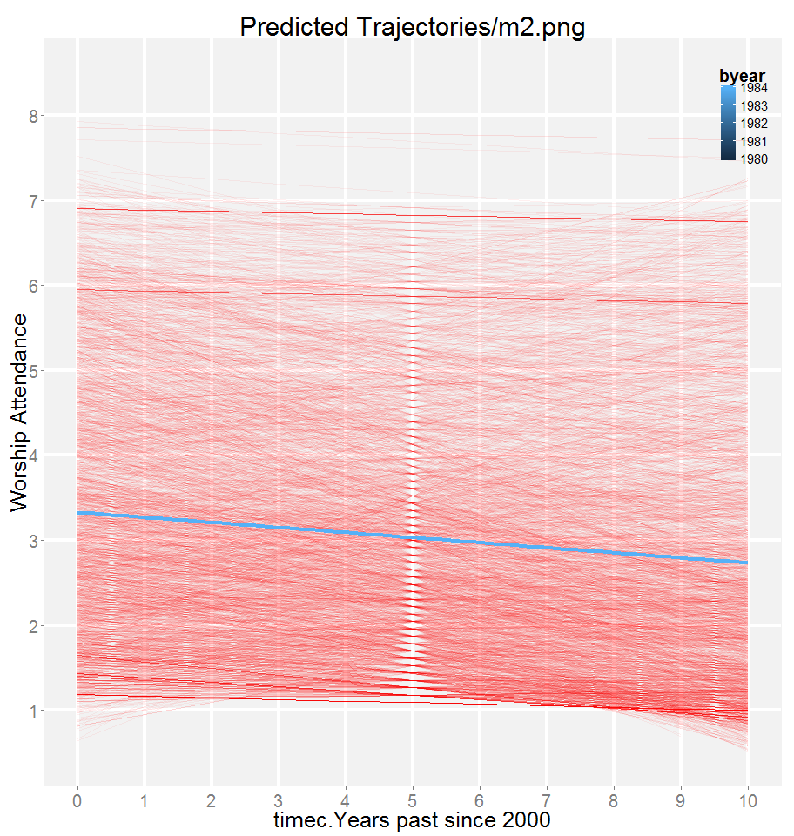
wave of measurement, centered at 2000 - timec
age in years in 2000, centered at 16 - agec
Graph
Fit
Output
Worship Attendance Scale |0
Everyday |8
>1/week|7
~ 1/week |6
~ 2/month |5
~ 1/month |4
< 1/month |3
Once -Twice |2
Never |1
(m2 <-lmer (attend ~
1 + timec
+ (1 + timec | id),
data = ds, REML=0))
MIXED attend WITH timec timec2 timec3 agec
/FIXED= INTERCEPT timec timec2 timec3
agec*timec agec*timec2 agec*timec3
/Random= INTERCEPT timec timec2 timec3 | SUBJECT(ID) COVTYP(UN)
SD / corr
SD
m2
0
1
2
3
4
5
6
7
8
9
10
11
12

Slide 14
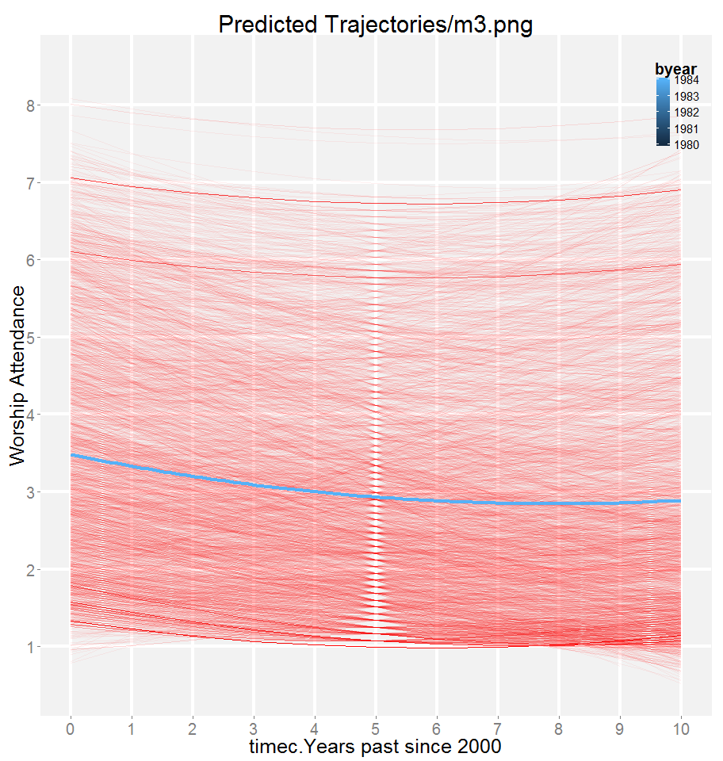
wave of measurement, centered at 2000 - timec
age in years in 2000, centered at 16 - agec
Graph
Fit
Output
Worship Attendance Scale |0
Everyday |8
>1/week|7
~ 1/week |6
~ 2/month |5
~ 1/month |4
< 1/month |3
Once -Twice |2
Never |1
(m3 <-lmer (attend ~
1 + timec + timec2
+ (1 + timec | id),
data = ds, REML=0))
MIXED attend WITH timec timec2 timec3 agec
/FIXED= INTERCEPT timec timec2 timec3
agec*timec agec*timec2 agec*timec3
/Random= INTERCEPT timec timec2 timec3 | SUBJECT(ID) COVTYP(UN)
SD / corr
SD
m3
0
1
2
3
4
5
6
7
8
9
10
11
12

Slide 15
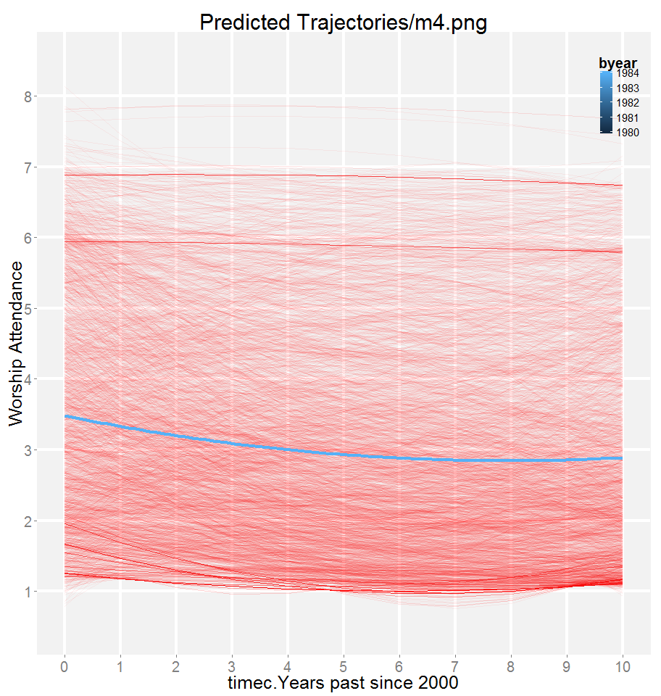
wave of measurement, centered at 2000 - timec
age in years in 2000, centered at 16 - agec
Graph
Fit
Output
Worship Attendance Scale |0
Everyday |8
>1/week|7
~ 1/week |6
~ 2/month |5
~ 1/month |4
< 1/month |3
Once -Twice |2
Never |1
(m4 <-lmer (attend ~
1 + timec + timec2
+ (1 + timec + timec2 | id),
data = ds, REML=0))
MIXED attend WITH timec timec2 timec3 agec
/FIXED= INTERCEPT timec timec2 timec3
agec*timec agec*timec2 agec*timec3
/Random= INTERCEPT timec timec2 timec3 | SUBJECT(ID) COVTYP(UN)
SD / corr
SD
m4
0
1
2
3
4
5
6
7
8
9
10
11
12

Slide 16

wave of measurement, centered at 2000 - timec
age in years in 2000, centered at 16 - agec
Graph
Fit
Output
Worship Attendance Scale |0
Everyday |8
>1/week|7
~ 1/week |6
~ 2/month |5
~ 1/month |4
< 1/month |3
Once -Twice |2
Never |1
(m5 <-lmer (attend ~
1 + timec + timec2 + timec3
+ (1 + timec + timec2 | id),
data = ds, REML=0))
MIXED attend WITH timec timec2 timec3 agec
/FIXED= INTERCEPT timec timec2 timec3
agec*timec agec*timec2 agec*timec3
/Random= INTERCEPT timec timec2 timec3 | SUBJECT(ID) COVTYP(UN)
SD / corr
SD
m5
0
1
2
3
4
5
6
7
8
9
10
11
12

Slide 17
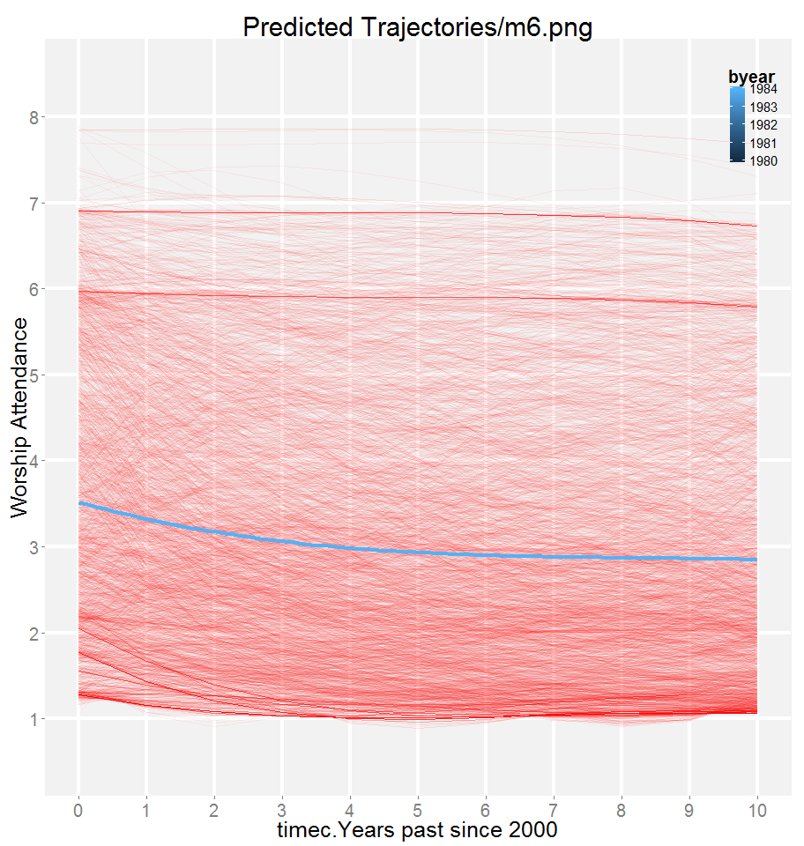
wave of measurement, centered at 2000 - timec
age in years in 2000, centered at 16 - agec
Graph
Fit
Output
Worship Attendance Scale |0
Everyday |8
>1/week|7
~ 1/week |6
~ 2/month |5
~ 1/month |4
< 1/month |3
Once -Twice |2
Never |1
(m6 <-lmer (attend ~
1 + timec + timec2 + timec3
+ (1 + timec + timec2 + timec3 | id),
data = ds, REML=0))
MIXED attend WITH timec timec2 timec3 agec
/FIXED= INTERCEPT timec timec2 timec3
agec*timec agec*timec2 agec*timec3
/Random= INTERCEPT timec timec2 timec3 | SUBJECT(ID) COVTYP(UN)
SD / corr
SD
m6
0
1
2
3
4
5
6
7
8
9
10
11
12

Slide 18
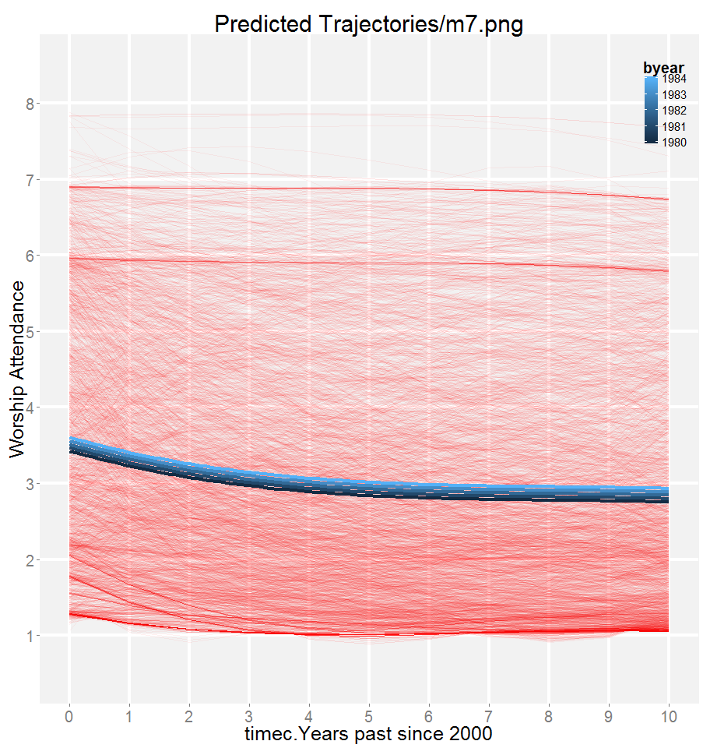
wave of measurement, centered at 2000 - timec
age in years in 2000, centered at 16 - agec
Graph
Fit
Output
Worship Attendance Scale |0
Everyday |8
>1/week|7
~ 1/week |6
~ 2/month |5
~ 1/month |4
< 1/month |3
Once -Twice |2
Never |1
(m7 <-lmer (attend ~
1 + timec + timec2 + timec3 + agec
+ (1 + timec + timec2 + timec3 | id),
data = ds, REML=0))
MIXED attend WITH timec timec2 timec3 agec
/FIXED= INTERCEPT timec timec2 timec3
agec agec*timec agec*timec2 agec*timec3
/Random= INTERCEPT timec timec2 timec3 | SUBJECT(ID) COVTYP(UN)
SD / corr
SD
m7
0
1
2
3
4
5
6
7
8
9
10
11
12

Slide 19
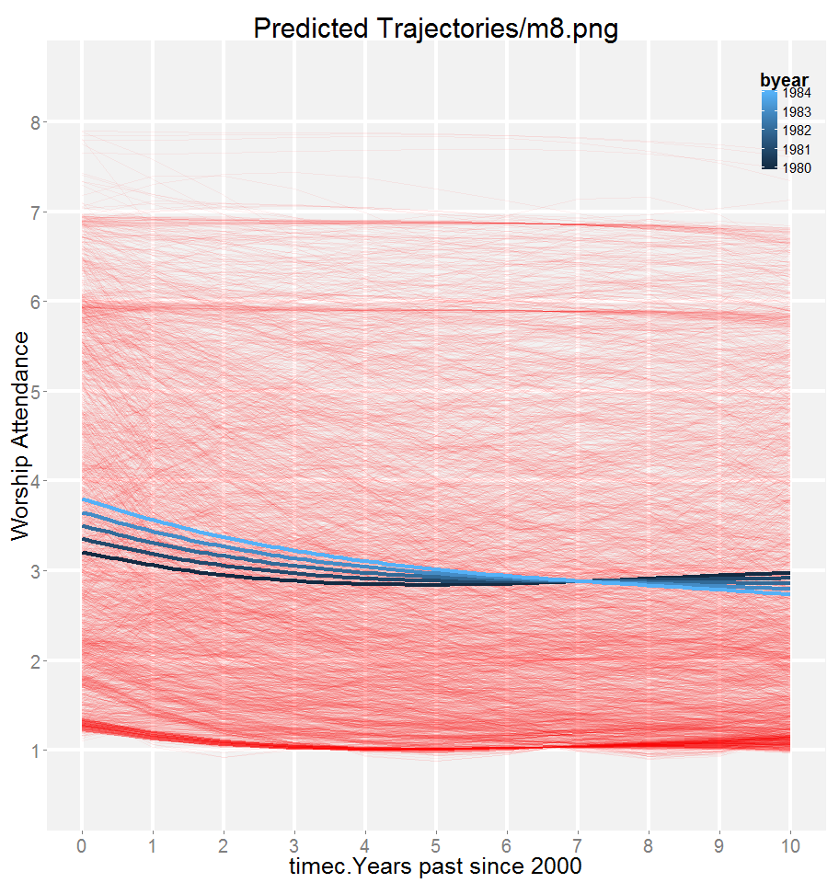
wave of measurement, centered at 2000 - timec
age in years in 2000, centered at 16 - agec
Graph
Fit
Output
Worship Attendance Scale |0
Everyday |8
>1/week|7
~ 1/week |6
~ 2/month |5
~ 1/month |4
< 1/month |3
Once -Twice |2
Never |1
(m8 <-lmer (attend ~
1 + timec + timec2 + timec3 + agec
+ agec:timec
+ (1 + timec + timec2 + timec3 | id),
data = ds, REML=0))
MIXED attend WITH timec timec2 timec3 agec
/FIXED= INTERCEPT timec timec2 timec3
agec agec*timec agec*timec2 agec*timec3
/Random= INTERCEPT timec timec2 timec3 | SUBJECT(ID) COVTYP(UN)
SD / corr
SD
m8
0
1
2
3
4
5
6
7
8
9
10
11
12

Slide 20
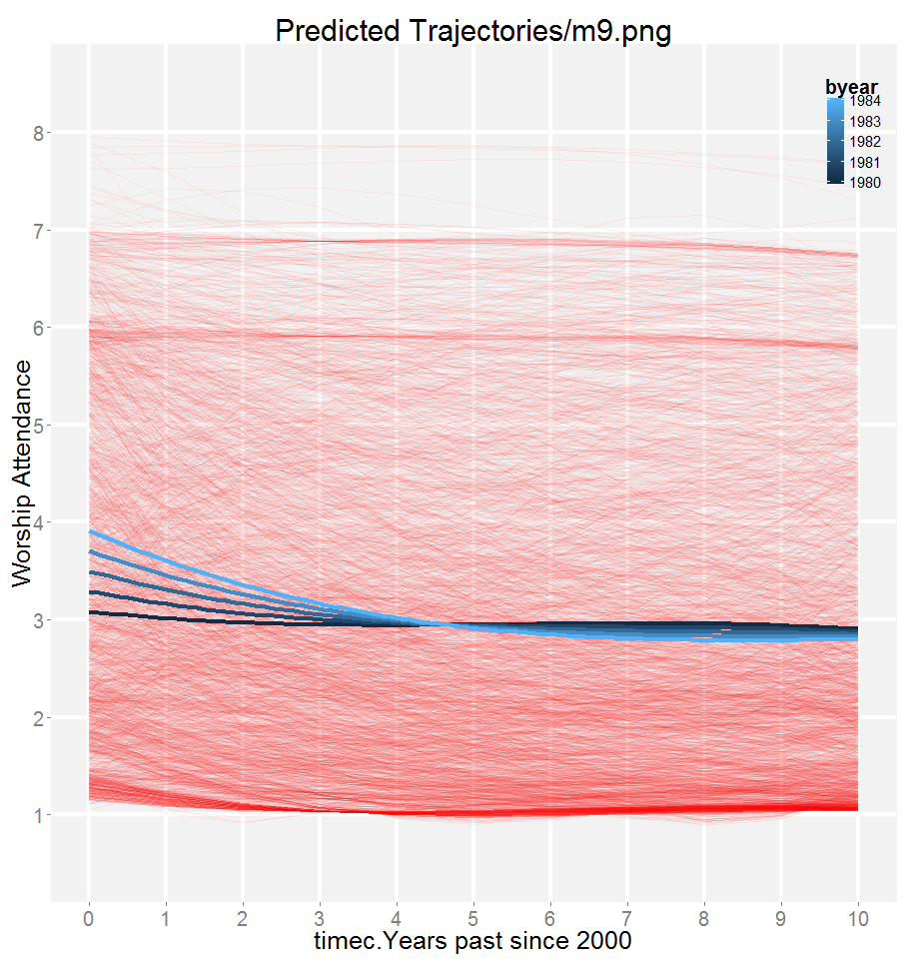
wave of measurement, centered at 2000 - timec
age in years in 2000, centered at 16 - agec
Graph
Fit
Output
Worship Attendance Scale |0
Everyday |8
>1/week|7
~ 1/week |6
~ 2/month |5
~ 1/month |4
< 1/month |3
Once -Twice |2
Never |1
(m9 <-lmer (attend ~
1 + timec + timec2 + timec3 + agec
+ agec:timec +agec:timec2
+ (1 + timec + timec2 + timec3 | id),
data = ds, REML=0))
MIXED attend WITH timec timec2 timec3 agec
/FIXED= INTERCEPT timec timec2 timec3
agec agec*timec agec*timec2 agec*timec3
/Random= INTERCEPT timec timec2 timec3 | SUBJECT(ID) COVTYP(UN)
SD / corr
SD
m9
0
1
2
3
4
5
6
7
8
9
10
11
12

Slide 21
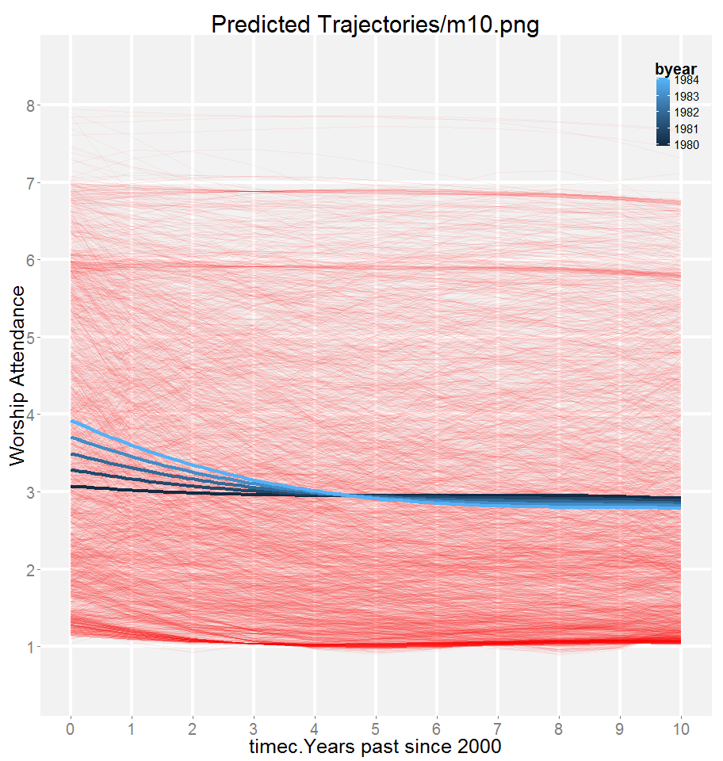
wave of measurement, centered at 2000 - timec
age in years in 2000, centered at 16 - agec
Graph
Fit
Output
Worship Attendance Scale |0
Everyday |8
>1/week|7
~ 1/week |6
~ 2/month |5
~ 1/month |4
< 1/month |3
Once -Twice |2
Never |1
(m10 <-lmer (attend ~
1 + timec + timec2 + timec3 + agec
+ agec:timec +agec:timec2 + agec:timec3
+ (1 + timec + timec2 + timec3 | id),
data = ds, REML=0))
MIXED attend WITH timec timec2 timec3 agec
/FIXED= INTERCEPT timec timec2 timec3
agec agec*timec agec*timec2 agec*timec3
/Random= INTERCEPT timec timec2 timec3 | SUBJECT(ID) COVTYP(UN)
SD / corr
SD
m10
0
1
2
3
4
5
6
7
8
9
10
11
12

Slide 22
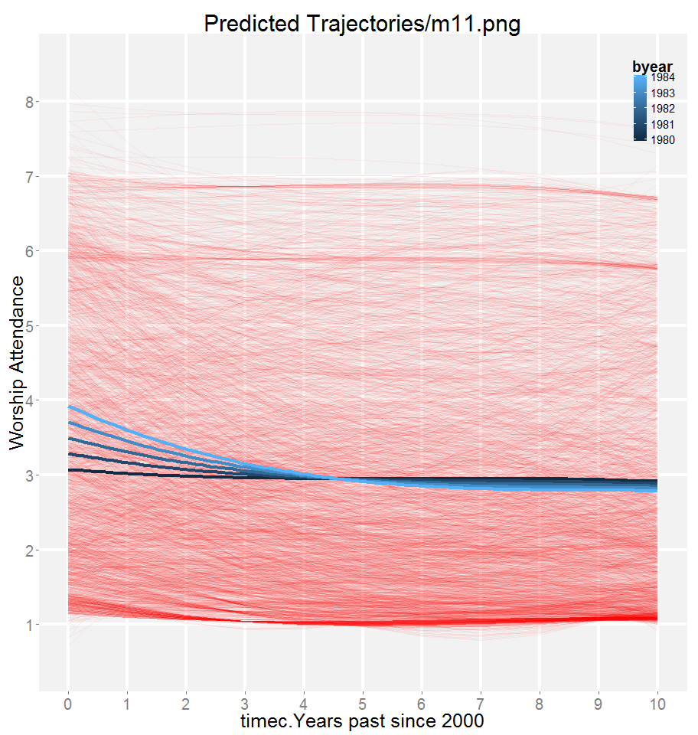
wave of measurement, centered at 2000 - timec
age in years in 2000, centered at 16 - agec
Graph
Fit
Output
Worship Attendance Scale |0
Everyday |8
>1/week|7
~ 1/week |6
~ 2/month |5
~ 1/month |4
< 1/month |3
Once -Twice |2
Never |1
(m11 <-lmer (attend ~
1 + timec + timec2 + timec3 + agec
+ agec:timec +agec:timec2 + agec:timec3
+ (1 + timec + timec2 | id),
data = ds, REML=0))
MIXED attend WITH timec timec2 timec3 agec
/FIXED= INTERCEPT timec timec2 timec3
agec agec*timec agec*timec2 agec*timec3
/Random= INTERCEPT timec timec2 timec3 | SUBJECT(ID) COVTYP(UN)
SD / corr
SD
m11
0
1
2
3
4
5
6
7
8
9
10
11
12

Slide 23
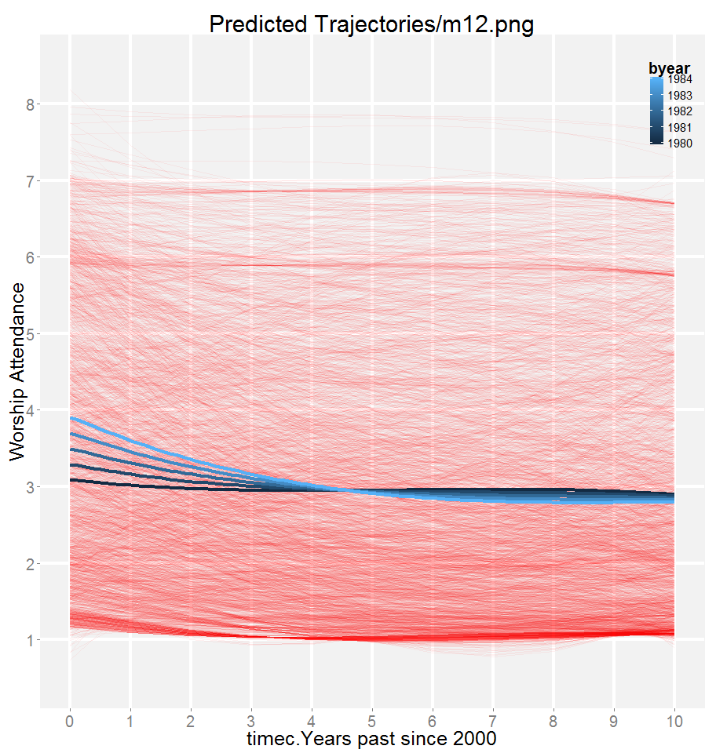
wave of measurement, centered at 2000 - timec
age in years in 2000, centered at 16 - agec
Graph
Fit
Output
Worship Attendance Scale |0
Everyday |8
>1/week|7
~ 1/week |6
~ 2/month |5
~ 1/month |4
< 1/month |3
Once -Twice |2
Never |1
(m12 <-lmer (attend ~
1 + timec + timec2 + timec3 + agec
+ agec:timec +agec:timec2
+ (1 + timec + timec2 | id),
data = ds, REML=0))
MIXED attend WITH timec timec2 timec3 agec
/FIXED= INTERCEPT timec timec2 timec3
agec agec*timec agec*timec2 agec*timec3
/Random= INTERCEPT timec timec2 timec3 | SUBJECT(ID) COVTYP(UN)
SD / corr
SD
m12
0
1
2
3
4
5
6
7
8
9
10
11
12
Notes:
The last slide on the Specification part

Slide 24
wave of measurement, centered at 2000 - timec
age in years in 2000, centered at 16 - agec
Graph
Fit
Output
Worship Attendance Scale |0
Everyday |8
>1/week|7
~ 1/week |6
~ 2/month |5
~ 1/month |4
< 1/month |3
Once -Twice |2
Never |1
(m00 <-lm (attend ~ 1),
data = ds, REML=0))
MIXED attend WITH timec timec2 timec3 agec
/FIXED= INTERCEPT timec timec2 timec3
agec*timec agec*timec2 agec*timec3
/Random= INTERCEPT timec timec2 timec3 | SUBJECT(ID) COVTYP(UN)
SD / corr
SD
m00
0
1
2
3
4
5
6
7
8
9
10
11
12
Notes:
But we will use building-up strategy instead. IMHO, it makes more sense to increase complexity gradually when first learning about data.
Between years 2000 and 2001 , people who in 2000 were between 16 and 20 years of age, attended worship service less than once a month (3.031) on average.
In other words, subjects were scoring a 3.031 on the NLSY97 worship attendance scale.

Slide 25
wave of measurement, centered at 2000 - timec
age in years in 2000, centered at 16 - agec
Graph
Fit
Output
Worship Attendance Scale |0
Everyday |8
>1/week|7
~ 1/week |6
~ 2/month |5
~ 1/month |4
< 1/month |3
Once -Twice |2
Never |1
(m0 <-lmer (attend ~
1 + (1 | id),
data = ds, REML=0))
MIXED attend WITH timec timec2 timec3 agec
/FIXED= INTERCEPT timec timec2 timec3
agec*timec agec*timec2 agec*timec3
/Random= INTERCEPT timec timec2 timec3 | SUBJECT(ID) COVTYP(UN)
SD / corr
SD
m0
0
1
2
3
4
5
6
7
8
9
10
11
12
Notes:
Null Model

Slide 26
wave of measurement, centered at 2000 - timec
age in years in 2000, centered at 16 - agec
Graph
Fit
Output
Worship Attendance Scale |0
Everyday |8
>1/week|7
~ 1/week |6
~ 2/month |5
~ 1/month |4
< 1/month |3
Once -Twice |2
Never |1
(m1 <-lmer (attend ~
1 + timec
+ (1 | id),
data = ds, REML=0))
MIXED attend WITH timec timec2 timec3 agec
/FIXED= INTERCEPT timec timec2 timec3
agec*timec agec*timec2 agec*timec3
/Random= INTERCEPT timec timec2 timec3 | SUBJECT(ID) COVTYP(UN)
SD / corr
SD
m1
0
1
2
3
4
5
6
7
8
9
10
11
12

Slide 27
wave of measurement, centered at 2000 - timec
age in years in 2000, centered at 16 - agec
Graph
Fit
Output
Worship Attendance Scale |0
Everyday |8
>1/week|7
~ 1/week |6
~ 2/month |5
~ 1/month |4
< 1/month |3
Once -Twice |2
Never |1
(m2 <-lmer (attend ~
1 + timec
+ (1 + timec | id),
data = ds, REML=0))
MIXED attend WITH timec timec2 timec3 agec
/FIXED= INTERCEPT timec timec2 timec3
agec*timec agec*timec2 agec*timec3
/Random= INTERCEPT timec timec2 timec3 | SUBJECT(ID) COVTYP(UN)
SD / corr
SD
m2
0
1
2
3
4
5
6
7
8
9
10
11
12

Slide 28
wave of measurement, centered at 2000 - timec
age in years in 2000, centered at 16 - agec
Graph
Fit
Output
Worship Attendance Scale |0
Everyday |8
>1/week|7
~ 1/week |6
~ 2/month |5
~ 1/month |4
< 1/month |3
Once -Twice |2
Never |1
(m3 <-lmer (attend ~
1 + timec + timec2
+ (1 + timec | id),
data = ds, REML=0))
MIXED attend WITH timec timec2 timec3 agec
/FIXED= INTERCEPT timec timec2 timec3
agec*timec agec*timec2 agec*timec3
/Random= INTERCEPT timec timec2 timec3 | SUBJECT(ID) COVTYP(UN)
SD / corr
SD
m3
0
1
2
3
4
5
6
7
8
9
10
11
12

Slide 29
wave of measurement, centered at 2000 - timec
age in years in 2000, centered at 16 - agec
Graph
Fit
Output
Worship Attendance Scale |0
Everyday |8
>1/week|7
~ 1/week |6
~ 2/month |5
~ 1/month |4
< 1/month |3
Once -Twice |2
Never |1
(m4 <-lmer (attend ~
1 + timec + timec2
+ (1 + timec + timec2 | id),
data = ds, REML=0))
MIXED attend WITH timec timec2 timec3 agec
/FIXED= INTERCEPT timec timec2 timec3
agec*timec agec*timec2 agec*timec3
/Random= INTERCEPT timec timec2 timec3 | SUBJECT(ID) COVTYP(UN)
SD / corr
SD
m4
0
1
2
3
4
5
6
7
8
9
10
11
12

Slide 30
wave of measurement, centered at 2000 - timec
age in years in 2000, centered at 16 - agec
Graph
Fit
Output
Worship Attendance Scale |0
Everyday |8
>1/week|7
~ 1/week |6
~ 2/month |5
~ 1/month |4
< 1/month |3
Once -Twice |2
Never |1
(m5 <-lmer (attend ~
1 + timec + timec2 + timec3
+ (1 + timec + timec2 | id),
data = ds, REML=0))
MIXED attend WITH timec timec2 timec3 agec
/FIXED= INTERCEPT timec timec2 timec3
agec*timec agec*timec2 agec*timec3
/Random= INTERCEPT timec timec2 timec3 | SUBJECT(ID) COVTYP(UN)
SD / corr
SD
m5
0
1
2
3
4
5
6
7
8
9
10
11
12

Slide 31
wave of measurement, centered at 2000 - timec
age in years in 2000, centered at 16 - agec
Graph
Fit
Output
Worship Attendance Scale |0
Everyday |8
>1/week|7
~ 1/week |6
~ 2/month |5
~ 1/month |4
< 1/month |3
Once -Twice |2
Never |1
(m6 <-lmer (attend ~
1 + timec + timec2 + timec3
+ (1 + timec + timec2 + timec3 | id),
data = ds, REML=0))
MIXED attend WITH timec timec2 timec3 agec
/FIXED= INTERCEPT timec timec2 timec3
agec*timec agec*timec2 agec*timec3
/Random= INTERCEPT timec timec2 timec3 | SUBJECT(ID) COVTYP(UN)
SD / corr
SD
m6
0
1
2
3
4
5
6
7
8
9
10
11
12

Slide 32
wave of measurement, centered at 2000 - timec
age in years in 2000, centered at 16 - agec
Graph
Fit
Output
Worship Attendance Scale |0
Everyday |8
>1/week|7
~ 1/week |6
~ 2/month |5
~ 1/month |4
< 1/month |3
Once -Twice |2
Never |1
(m7 <-lmer (attend ~
1 + timec + timec2 + timec3 + agec
+ (1 + timec + timec2 + timec3 | id),
data = ds, REML=0))
MIXED attend WITH timec timec2 timec3 agec
/FIXED= INTERCEPT timec timec2 timec3
agec agec*timec agec*timec2 agec*timec3
/Random= INTERCEPT timec timec2 timec3 | SUBJECT(ID) COVTYP(UN)
SD / corr
SD
m7
0
1
2
3
4
5
6
7
8
9
10
11
12

Slide 33
wave of measurement, centered at 2000 - timec
age in years in 2000, centered at 16 - agec
Graph
Fit
Output
Worship Attendance Scale |0
Everyday |8
>1/week|7
~ 1/week |6
~ 2/month |5
~ 1/month |4
< 1/month |3
Once -Twice |2
Never |1
(m8 <-lmer (attend ~
1 + timec + timec2 + timec3 + agec
+ agec:timec
+ (1 + timec + timec2 + timec3 | id),
data = ds, REML=0))
MIXED attend WITH timec timec2 timec3 agec
/FIXED= INTERCEPT timec timec2 timec3
agec agec*timec agec*timec2 agec*timec3
/Random= INTERCEPT timec timec2 timec3 | SUBJECT(ID) COVTYP(UN)
SD / corr
SD
m8
0
1
2
3
4
5
6
7
8
9
10
11
12

Slide 34
wave of measurement, centered at 2000 - timec
age in years in 2000, centered at 16 - agec
Graph
Fit
Output
Worship Attendance Scale |0
Everyday |8
>1/week|7
~ 1/week |6
~ 2/month |5
~ 1/month |4
< 1/month |3
Once -Twice |2
Never |1
(m9 <-lmer (attend ~
1 + timec + timec2 + timec3 + agec
+ agec:timec +agec:timec2
+ (1 + timec + timec2 + timec3 | id),
data = ds, REML=0))
MIXED attend WITH timec timec2 timec3 agec
/FIXED= INTERCEPT timec timec2 timec3
agec agec*timec agec*timec2 agec*timec3
/Random= INTERCEPT timec timec2 timec3 | SUBJECT(ID) COVTYP(UN)
SD / corr
SD
m9
0
1
2
3
4
5
6
7
8
9
10
11
12

Slide 35
wave of measurement, centered at 2000 - timec
age in years in 2000, centered at 16 - agec
Graph
Fit
Output
Worship Attendance Scale |0
Everyday |8
>1/week|7
~ 1/week |6
~ 2/month |5
~ 1/month |4
< 1/month |3
Once -Twice |2
Never |1
(m10 <-lmer (attend ~
1 + timec + timec2 + timec3 + agec
+ agec:timec +agec:timec2 + agec:timec3
+ (1 + timec + timec2 + timec3 | id),
data = ds, REML=0))
MIXED attend WITH timec timec2 timec3 agec
/FIXED= INTERCEPT timec timec2 timec3
agec agec*timec agec*timec2 agec*timec3
/Random= INTERCEPT timec timec2 timec3 | SUBJECT(ID) COVTYP(UN)
SD / corr
SD
m10
0
1
2
3
4
5
6
7
8
9
10
11
12

Slide 36
wave of measurement, centered at 2000 - timec
age in years in 2000, centered at 16 - agec
Graph
Fit
Output
Worship Attendance Scale |0
Everyday |8
>1/week|7
~ 1/week |6
~ 2/month |5
~ 1/month |4
< 1/month |3
Once -Twice |2
Never |1
(m11 <-lmer (attend ~
1 + timec + timec2 + timec3 + agec
+ agec:timec +agec:timec2 + agec:timec3
+ (1 + timec + timec2 | id),
data = ds, REML=0))
MIXED attend WITH timec timec2 timec3 agec
/FIXED= INTERCEPT timec timec2 timec3
agec agec*timec agec*timec2 agec*timec3
/Random= INTERCEPT timec timec2 timec3 | SUBJECT(ID) COVTYP(UN)
SD / corr
SD
m11
0
1
2
3
4
5
6
7
8
9
10
11
12

Slide 37
wave of measurement, centered at 2000 - timec
age in years in 2000, centered at 16 - agec
Graph
Fit
Output
Worship Attendance Scale |0
Everyday |8
>1/week|7
~ 1/week |6
~ 2/month |5
~ 1/month |4
< 1/month |3
Once -Twice |2
Never |1
(m12 <-lmer (attend ~
1 + timec + timec2 + timec3 + agec
+ agec:timec +agec:timec2
+ (1 + timec + timec2 | id),
data = ds, REML=0))
MIXED attend WITH timec timec2 timec3 agec
/FIXED= INTERCEPT timec timec2 timec3
agec agec*timec agec*timec2 agec*timec3
/Random= INTERCEPT timec timec2 timec3 | SUBJECT(ID) COVTYP(UN)
SD / corr
SD
m12
0
1
2
3
4
5
6
7
8
9
10
11
12

Slide 38
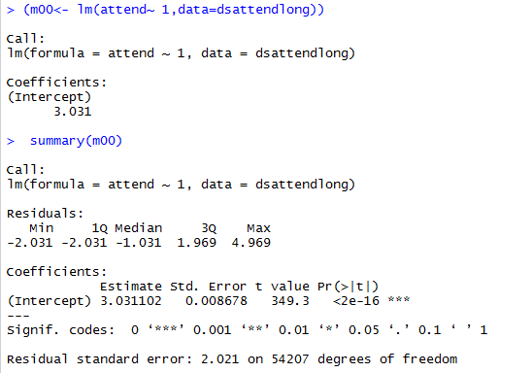
wave of measurement, centered at 2000 - timec
age in years in 2000, centered at 16 - agec
Graph
Fit
Output
Worship Attendance Scale |0
Everyday |8
>1/week|7
~ 1/week |6
~ 2/month |5
~ 1/month |4
< 1/month |3
Once -Twice |2
Never |1
(m00 <-lm (attend ~ 1),
data = ds, REML=0))
MIXED attend WITH timec timec2 timec3 agec
/FIXED= INTERCEPT timec timec2 timec3
agec*timec agec*timec2 agec*timec3
/Random= INTERCEPT timec timec2 timec3 | SUBJECT(ID) COVTYP(UN)
SD / corr
SD
m00
0
1
2
3
4
5
6
7
8
9
10
11
12

Slide 39
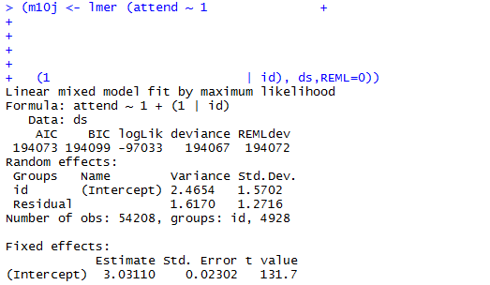
wave of measurement, centered at 2000 - timec
age in years in 2000, centered at 16 - agec
Graph
Fit
Output
Worship Attendance Scale |0
Everyday |8
>1/week|7
~ 1/week |6
~ 2/month |5
~ 1/month |4
< 1/month |3
Once -Twice |2
Never |1
(m0 <-lmer (attend ~
1 + (1 | id),
data = ds, REML=0))
MIXED attend WITH timec timec2 timec3 agec
/FIXED= INTERCEPT timec timec2 timec3
agec*timec agec*timec2 agec*timec3
/Random= INTERCEPT timec timec2 timec3 | SUBJECT(ID) COVTYP(UN)
SD / corr
SD
m0
0
1
2
3
4
5
6
7
8
9
10
11
12
Notes:
Between 2000 and 2010, people between who in 2000 were between 16 and 20 years of age attended worship service on average less than once a month (3.031).
On average, subjects varied by an average of 1.57 points on the WAS ( Worship Attendance Scale)

Slide 40
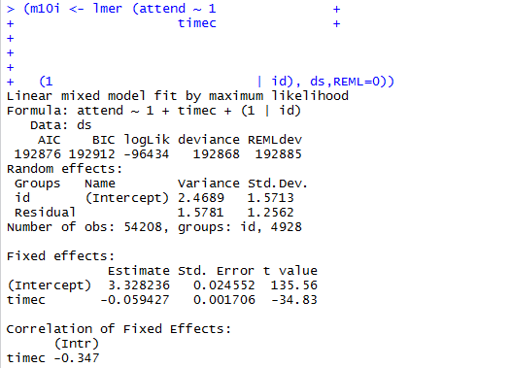
wave of measurement, centered at 2000 - timec
age in years in 2000, centered at 16 - agec
Graph
Fit
Output
Worship Attendance Scale |0
Everyday |8
>1/week|7
~ 1/week |6
~ 2/month |5
~ 1/month |4
< 1/month |3
Once -Twice |2
Never |1
(m1 <-lmer (attend ~
1 + timec
+ (1 | id),
data = ds, REML=0))
MIXED attend WITH timec timec2 timec3 agec
/FIXED= INTERCEPT timec timec2 timec3
agec*timec agec*timec2 agec*timec3
/Random= INTERCEPT timec timec2 timec3 | SUBJECT(ID) COVTYP(UN)
SD / corr
SD
m1
0
1
2
3
4
5
6
7
8
9
10
11
12
Notes:
In 2000, people between 16 and 20 years of age attended worship service on average less than once a month (3.328).
Regardless of subjects’ age, they were expected to decrease their worship attendance by 0.059 points on WAS every year after 2000.

Slide 41
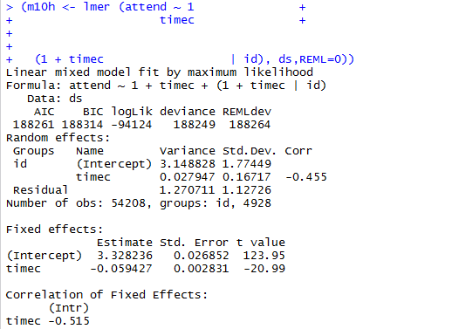
wave of measurement, centered at 2000 - timec
age in years in 2000, centered at 16 - agec
Graph
Fit
Output
Worship Attendance Scale |0
Everyday |8
>1/week|7
~ 1/week |6
~ 2/month |5
~ 1/month |4
< 1/month |3
Once -Twice |2
Never |1
(m2 <-lmer (attend ~
1 + timec
+ (1 + timec | id),
data = ds, REML=0))
MIXED attend WITH timec timec2 timec3 agec
/FIXED= INTERCEPT timec timec2 timec3
agec*timec agec*timec2 agec*timec3
/Random= INTERCEPT timec timec2 timec3 | SUBJECT(ID) COVTYP(UN)
SD / corr
SD
m2
0
1
2
3
4
5
6
7
8
9
10
11
12
Notes:
In 2000, people between 16 and 20 years of age scored an average of 3.328 points on WAS.
Regardless of subjects’ age, they were expected to decrease their worship attendance by an average of 0.059 points every year after 2000.
Subjects varied on the rate of this decline by an average of 0.17 points of WAS

Slide 42
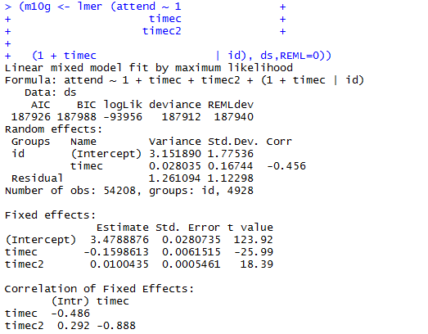
wave of measurement, centered at 2000 - timec
age in years in 2000, centered at 16 - agec
Graph
Fit
Output
Worship Attendance Scale |0
Everyday |8
>1/week|7
~ 1/week |6
~ 2/month |5
~ 1/month |4
< 1/month |3
Once -Twice |2
Never |1
(m3 <-lmer (attend ~
1 + timec + timec2
+ (1 + timec | id),
data = ds, REML=0))
MIXED attend WITH timec timec2 timec3 agec
/FIXED= INTERCEPT timec timec2 timec3
agec*timec agec*timec2 agec*timec3
/Random= INTERCEPT timec timec2 timec3 | SUBJECT(ID) COVTYP(UN)
SD / corr
SD
m3
0
1
2
3
4
5
6
7
8
9
10
11
12
Notes:
done

Slide 43
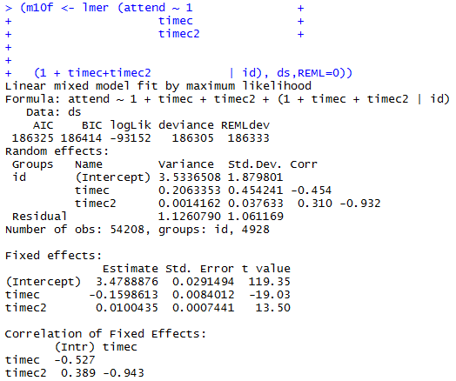
wave of measurement, centered at 2000 - timec
age in years in 2000, centered at 16 - agec
Graph
Fit
Output
Worship Attendance Scale |0
Everyday |8
>1/week|7
~ 1/week |6
~ 2/month |5
~ 1/month |4
< 1/month |3
Once -Twice |2
Never |1
(m4 <-lmer (attend ~
1 + timec + timec2
+ (1 + timec + timec2 | id),
data = ds, REML=0))
MIXED attend WITH timec timec2 timec3 agec
/FIXED= INTERCEPT timec timec2 timec3
agec*timec agec*timec2 agec*timec3
/Random= INTERCEPT timec timec2 timec3 | SUBJECT(ID) COVTYP(UN)
SD / corr
SD
m4
0
1
2
3
4
5
6
7
8
9
10
11
12
Notes:
done

Slide 44
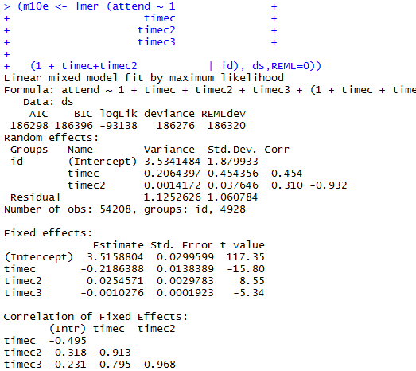
wave of measurement, centered at 2000 - timec
age in years in 2000, centered at 16 - agec
Graph
Fit
Output
Worship Attendance Scale |0
Everyday |8
>1/week|7
~ 1/week |6
~ 2/month |5
~ 1/month |4
< 1/month |3
Once -Twice |2
Never |1
(m5 <-lmer (attend ~
1 + timec + timec2 + timec3
+ (1 + timec + timec2 | id),
data = ds, REML=0))
MIXED attend WITH timec timec2 timec3 agec
/FIXED= INTERCEPT timec timec2 timec3
agec*timec agec*timec2 agec*timec3
/Random= INTERCEPT timec timec2 timec3 | SUBJECT(ID) COVTYP(UN)
SD / corr
SD
m5
0
1
2
3
4
5
6
7
8
9
10
11
12
Notes:
done

Slide 45
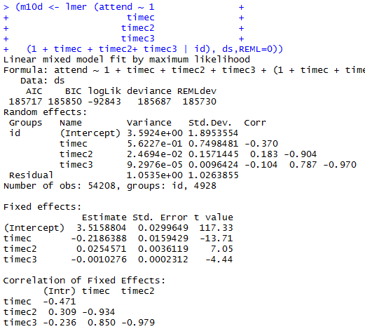
wave of measurement, centered at 2000 - timec
age in years in 2000, centered at 16 - agec
Graph
Fit
Output
Worship Attendance Scale |0
Everyday |8
>1/week|7
~ 1/week |6
~ 2/month |5
~ 1/month |4
< 1/month |3
Once -Twice |2
Never |1
(m6 <-lmer (attend ~
1 + timec + timec2 + timec3
+ (1 + timec + timec2 + timec3 | id),
data = ds, REML=0))
MIXED attend WITH timec timec2 timec3 agec
/FIXED= INTERCEPT timec timec2 timec3
agec*timec agec*timec2 agec*timec3
/Random= INTERCEPT timec timec2 timec3 | SUBJECT(ID) COVTYP(UN)
SD / corr
SD
m6
0
1
2
3
4
5
6
7
8
9
10
11
12
Notes:
done

Slide 46
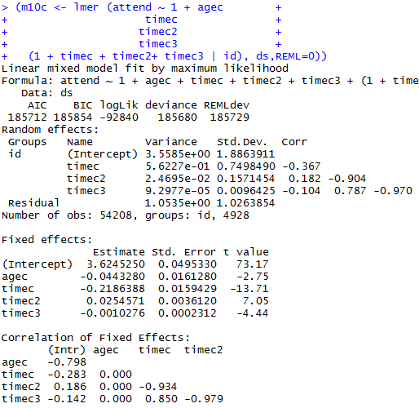
wave of measurement, centered at 2000 - timec
age in years in 2000, centered at 16 - agec
Graph
Fit
Output
Worship Attendance Scale |0
Everyday |8
>1/week|7
~ 1/week |6
~ 2/month |5
~ 1/month |4
< 1/month |3
Once -Twice |2
Never |1
(m7 <-lmer (attend ~
1 + timec + timec2 + timec3 + agec
+ (1 + timec + timec2 + timec3 | id),
data = ds, REML=0))
MIXED attend WITH timec timec2 timec3 agec
/FIXED= INTERCEPT timec timec2 timec3
agec agec*timec agec*timec2 agec*timec3
/Random= INTERCEPT timec timec2 timec3 | SUBJECT(ID) COVTYP(UN)
SD / corr
SD
m7
0
1
2
3
4
5
6
7
8
9
10
11
12
Notes:
Every additional year difference in age was associated with 0.044 WAS point decrease of worship attendance in 2000. Older subjects attended worship less, -0.044 points for every year of age.

Slide 47
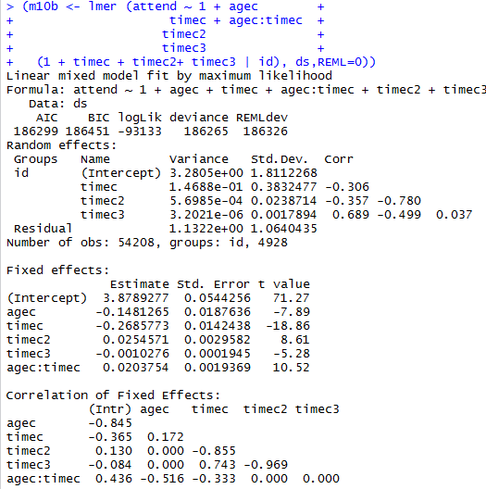
wave of measurement, centered at 2000 - timec
age in years in 2000, centered at 16 - agec
Graph
Fit
Output
Worship Attendance Scale |0
Everyday |8
>1/week|7
~ 1/week |6
~ 2/month |5
~ 1/month |4
< 1/month |3
Once -Twice |2
Never |1
(m8 <-lmer (attend ~
1 + timec + timec2 + timec3 + agec
+ agec:timec
+ (1 + timec + timec2 + timec3 | id),
data = ds, REML=0))
MIXED attend WITH timec timec2 timec3 agec
/FIXED= INTERCEPT timec timec2 timec3
agec agec*timec agec*timec2 agec*timec3
/Random= INTERCEPT timec timec2 timec3 | SUBJECT(ID) COVTYP(UN)
SD / corr
SD
m8
0
1
2
3
4
5
6
7
8
9
10
11
12
Notes:
Tearing down

Slide 48
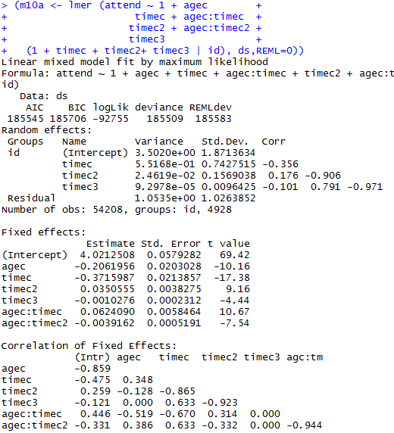
wave of measurement, centered at 2000 - timec
age in years in 2000, centered at 16 - agec
Graph
Fit
Output
Worship Attendance Scale |0
Everyday |8
>1/week|7
~ 1/week |6
~ 2/month |5
~ 1/month |4
< 1/month |3
Once -Twice |2
Never |1
(m9 <-lmer (attend ~
1 + timec + timec2 + timec3 + agec
+ agec:timec +agec:timec2
+ (1 + timec + timec2 + timec3 | id),
data = ds, REML=0))
MIXED attend WITH timec timec2 timec3 agec
/FIXED= INTERCEPT timec timec2 timec3
agec agec*timec agec*timec2 agec*timec3
/Random= INTERCEPT timec timec2 timec3 | SUBJECT(ID) COVTYP(UN)
SD / corr
SD
m9
0
1
2
3
4
5
6
7
8
9
10
11
12
Notes:
Tearing down

Slide 49
wave of measurement, centered at 2000 - timec
age in years in 2000, centered at 16 - agec
Graph
Fit
Output
Worship Attendance Scale |0
Everyday |8
>1/week|7
~ 1/week |6
~ 2/month |5
~ 1/month |4
< 1/month |3
Once -Twice |2
Never |1
(m10 <-lmer (attend ~
1 + timec + timec2 + timec3 + agec
+ agec:timec +agec:timec2 + agec:timec3
+ (1 + timec + timec2 + timec3 | id),
data = ds, REML=0))
MIXED attend WITH timec timec2 timec3 agec
/FIXED= INTERCEPT timec timec2 timec3
agec agec*timec agec*timec2 agec*timec3
/Random= INTERCEPT timec timec2 timec3 | SUBJECT(ID) COVTYP(UN)
SD / corr
SD
m10
0
1
2
3
4
5
6
7
8
9
10
11
12
Notes:
done

Slide 50
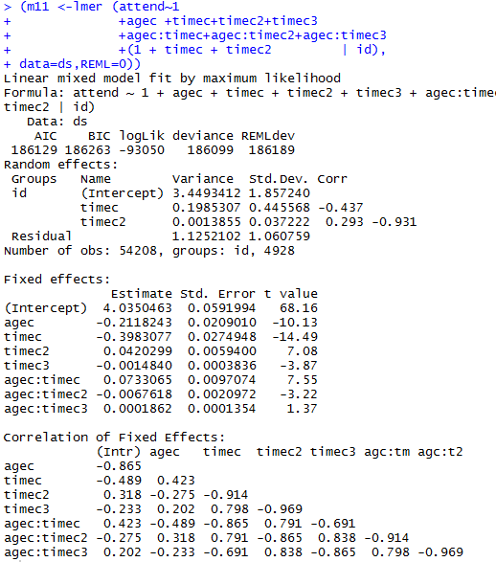
wave of measurement, centered at 2000 - timec
age in years in 2000, centered at 16 - agec
Graph
Fit
Output
Worship Attendance Scale |0
Everyday |8
>1/week|7
~ 1/week |6
~ 2/month |5
~ 1/month |4
< 1/month |3
Once -Twice |2
Never |1
(m11 <-lmer (attend ~
1 + timec + timec2 + timec3 + agec
+ agec:timec +agec:timec2 + agec:timec3
+ (1 + timec + timec2 | id),
data = ds, REML=0))
MIXED attend WITH timec timec2 timec3 agec
/FIXED= INTERCEPT timec timec2 timec3
agec agec*timec agec*timec2 agec*timec3
/Random= INTERCEPT timec timec2 timec3 | SUBJECT(ID) COVTYP(UN)
SD / corr
SD
m11
0
1
2
3
4
5
6
7
8
9
10
11
12
Notes:
done

Slide 51
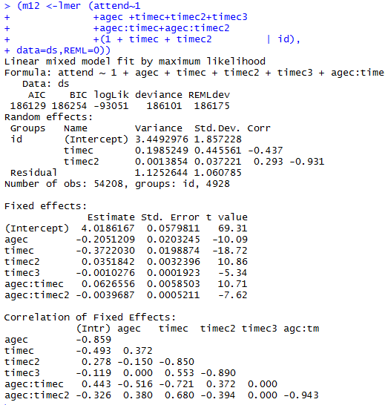
wave of measurement, centered at 2000 - timec
age in years in 2000, centered at 16 - agec
Graph
Fit
Output
Worship Attendance Scale |0
Everyday |8
>1/week|7
~ 1/week |6
~ 2/month |5
~ 1/month |4
< 1/month |3
Once -Twice |2
Never |1
(m12 <-lmer (attend ~
1 + timec + timec2 + timec3 + agec
+ agec:timec +agec:timec2
+ (1 + timec + timec2 | id),
data = ds, REML=0))
MIXED attend WITH timec timec2 timec3 agec
/FIXED= INTERCEPT timec timec2 timec3
agec agec*timec agec*timec2 agec*timec3
/Random= INTERCEPT timec timec2 timec3 | SUBJECT(ID) COVTYP(UN)
SD / corr
SD
m12
0
1
2
3
4
5
6
7
8
9
10
11
12
Notes:
done

Slide 52

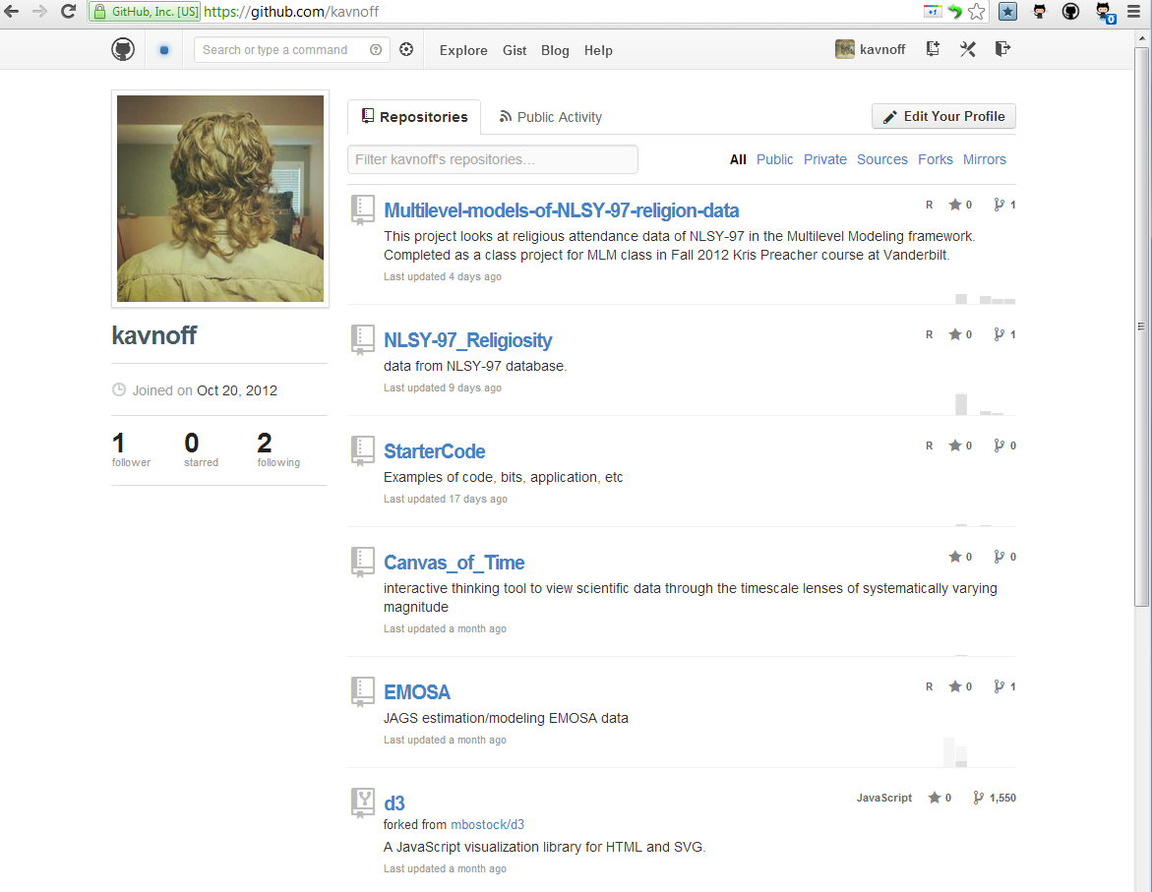


Slide 53
(m10 <-lmer (attend ~
1 + timec + timec2 + timec3 + agec
+ agec:timec +agec:timec2 +agec:timec3
+ (1 + timec + timec2 + timec3 | id),
data = ds, REML=0))

Slide 54
wave of measurement, centered at 2000 - timec
age in years in 2000, centered at 16 - agec
Graph
Fit
Output
Worship Attendance Scale |0
Everyday |8
>1/week|7
~ 1/week |6
~ 2/month |5
~ 1/month |4
< 1/month |3
Once -Twice |2
Never |1
(m00 <-lm (attend ~ 1),
data = ds, REML=0))
MIXED attend WITH timec timec2 timec3 agec
/FIXED= INTERCEPT timec timec2 timec3
agec*timec agec*timec2 agec*timec3
/Random= INTERCEPT timec timec2 timec3 | SUBJECT(ID) COVTYP(UN)
SD / corr
SD
m00
0
1
2
3
4
5
6
7
8
9
10
11
12

Slide 55
wave of measurement, centered at 2000 - timec
age in years in 2000, centered at 16 - agec
Graph
Fit
Output
Worship Attendance Scale |0
Everyday |8
>1/week|7
~ 1/week |6
~ 2/month |5
~ 1/month |4
< 1/month |3
Once -Twice |2
Never |1
(m0 <-lmer (attend ~
1 + (1 | id),
data = ds, REML=0))
MIXED attend WITH timec timec2 timec3 agec
/FIXED= INTERCEPT timec timec2 timec3
agec*timec agec*timec2 agec*timec3
/Random= INTERCEPT timec timec2 timec3 | SUBJECT(ID) COVTYP(UN)
SD / corr
SD
m0
0
1
2
3
4
5
6
7
8
9
10
11
12
Notes:
Between 2000 and 2010, people between who in 2000 were between 16 and 20 years of age attended worship service on average less than once a month (3.031).
On average, subjects varied by an average of 1.57 points on the WAS ( Worship Attendance Scale)

Slide 56
wave of measurement, centered at 2000 - timec
age in years in 2000, centered at 16 - agec
Graph
Fit
Output
Worship Attendance Scale |0
Everyday |8
>1/week|7
~ 1/week |6
~ 2/month |5
~ 1/month |4
< 1/month |3
Once -Twice |2
Never |1
(m1 <-lmer (attend ~
1 + timec
+ (1 | id),
data = ds, REML=0))
MIXED attend WITH timec timec2 timec3 agec
/FIXED= INTERCEPT timec timec2 timec3
agec*timec agec*timec2 agec*timec3
/Random= INTERCEPT timec timec2 timec3 | SUBJECT(ID) COVTYP(UN)
SD / corr
SD
m1
0
1
2
3
4
5
6
7
8
9
10
11
12
Notes:
In 2000, people between 16 and 20 years of age attended worship service on average less than once a month (3.328).
Regardless of subjects’ age, they were expected to decrease their worship attendance by 0.059 points on WAS every year after 2000.

Slide 57
wave of measurement, centered at 2000 - timec
age in years in 2000, centered at 16 - agec
Graph
Fit
Output
Worship Attendance Scale |0
Everyday |8
>1/week|7
~ 1/week |6
~ 2/month |5
~ 1/month |4
< 1/month |3
Once -Twice |2
Never |1
(m2 <-lmer (attend ~
1 + timec
+ (1 + timec | id),
data = ds, REML=0))
MIXED attend WITH timec timec2 timec3 agec
/FIXED= INTERCEPT timec timec2 timec3
agec*timec agec*timec2 agec*timec3
/Random= INTERCEPT timec timec2 timec3 | SUBJECT(ID) COVTYP(UN)
SD / corr
SD
m2
0
1
2
3
4
5
6
7
8
9
10
11
12
Notes:
In 2000, people between 16 and 20 years of age scored an average of 3.328 points on WAS.
Regardless of subjects’ age, they were expected to decrease their worship attendance by an average of 0.059 points every year after 2000.
Subjects varied on the rate of this decline by an average of 0.17 points of WAS

Slide 58
wave of measurement, centered at 2000 - timec
age in years in 2000, centered at 16 - agec
Graph
Fit
Output
Worship Attendance Scale |0
Everyday |8
>1/week|7
~ 1/week |6
~ 2/month |5
~ 1/month |4
< 1/month |3
Once -Twice |2
Never |1
(m3 <-lmer (attend ~
1 + timec + timec2
+ (1 + timec | id),
data = ds, REML=0))
MIXED attend WITH timec timec2 timec3 agec
/FIXED= INTERCEPT timec timec2 timec3
agec*timec agec*timec2 agec*timec3
/Random= INTERCEPT timec timec2 timec3 | SUBJECT(ID) COVTYP(UN)
SD / corr
SD
m3
0
1
2
3
4
5
6
7
8
9
10
11
12
Notes:
done

Slide 59
wave of measurement, centered at 2000 - timec
age in years in 2000, centered at 16 - agec
Graph
Fit
Output
Worship Attendance Scale |0
Everyday |8
>1/week|7
~ 1/week |6
~ 2/month |5
~ 1/month |4
< 1/month |3
Once -Twice |2
Never |1
(m4 <-lmer (attend ~
1 + timec + timec2
+ (1 + timec + timec2 | id),
data = ds, REML=0))
MIXED attend WITH timec timec2 timec3 agec
/FIXED= INTERCEPT timec timec2 timec3
agec*timec agec*timec2 agec*timec3
/Random= INTERCEPT timec timec2 timec3 | SUBJECT(ID) COVTYP(UN)
SD / corr
SD
m4
0
1
2
3
4
5
6
7
8
9
10
11
12
Notes:
done

Slide 60
wave of measurement, centered at 2000 - timec
age in years in 2000, centered at 16 - agec
Graph
Fit
Output
Worship Attendance Scale |0
Everyday |8
>1/week|7
~ 1/week |6
~ 2/month |5
~ 1/month |4
< 1/month |3
Once -Twice |2
Never |1
(m5 <-lmer (attend ~
1 + timec + timec2 + timec3
+ (1 + timec + timec2 | id),
data = ds, REML=0))
MIXED attend WITH timec timec2 timec3 agec
/FIXED= INTERCEPT timec timec2 timec3
agec*timec agec*timec2 agec*timec3
/Random= INTERCEPT timec timec2 timec3 | SUBJECT(ID) COVTYP(UN)
SD / corr
SD
m5
0
1
2
3
4
5
6
7
8
9
10
11
12
Notes:
done

Slide 61
wave of measurement, centered at 2000 - timec
age in years in 2000, centered at 16 - agec
Graph
Fit
Output
Worship Attendance Scale |0
Everyday |8
>1/week|7
~ 1/week |6
~ 2/month |5
~ 1/month |4
< 1/month |3
Once -Twice |2
Never |1
(m6 <-lmer (attend ~
1 + timec + timec2 + timec3
+ (1 + timec + timec2 + timec3 | id),
data = ds, REML=0))
MIXED attend WITH timec timec2 timec3 agec
/FIXED= INTERCEPT timec timec2 timec3
agec*timec agec*timec2 agec*timec3
/Random= INTERCEPT timec timec2 timec3 | SUBJECT(ID) COVTYP(UN)
SD / corr
SD
m6
0
1
2
3
4
5
6
7
8
9
10
11
12
Notes:
done

Slide 62
wave of measurement, centered at 2000 - timec
age in years in 2000, centered at 16 - agec
Graph
Fit
Output
Worship Attendance Scale |0
Everyday |8
>1/week|7
~ 1/week |6
~ 2/month |5
~ 1/month |4
< 1/month |3
Once -Twice |2
Never |1
(m7 <-lmer (attend ~
1 + timec + timec2 + timec3 + agec
+ (1 + timec + timec2 + timec3 | id),
data = ds, REML=0))
MIXED attend WITH timec timec2 timec3 agec
/FIXED= INTERCEPT timec timec2 timec3
agec agec*timec agec*timec2 agec*timec3
/Random= INTERCEPT timec timec2 timec3 | SUBJECT(ID) COVTYP(UN)
SD / corr
SD
m7
0
1
2
3
4
5
6
7
8
9
10
11
12
Notes:
Every additional year difference in age was associated with 0.044 WAS point decrease of worship attendance in 2000. Older subjects attended worship less, -0.044 points for every year of age.

Slide 63
wave of measurement, centered at 2000 - timec
age in years in 2000, centered at 16 - agec
Graph
Fit
Output
Worship Attendance Scale |0
Everyday |8
>1/week|7
~ 1/week |6
~ 2/month |5
~ 1/month |4
< 1/month |3
Once -Twice |2
Never |1
(m8 <-lmer (attend ~
1 + timec + timec2 + timec3 + agec
+ agec:timec
+ (1 + timec + timec2 + timec3 | id),
data = ds, REML=0))
MIXED attend WITH timec timec2 timec3 agec
/FIXED= INTERCEPT timec timec2 timec3
agec agec*timec agec*timec2 agec*timec3
/Random= INTERCEPT timec timec2 timec3 | SUBJECT(ID) COVTYP(UN)
SD / corr
SD
m8
0
1
2
3
4
5
6
7
8
9
10
11
12
Notes:
Tearing down

Slide 64
wave of measurement, centered at 2000 - timec
age in years in 2000, centered at 16 - agec
Graph
Fit
Output
Worship Attendance Scale |0
Everyday |8
>1/week|7
~ 1/week |6
~ 2/month |5
~ 1/month |4
< 1/month |3
Once -Twice |2
Never |1
(m9 <-lmer (attend ~
1 + timec + timec2 + timec3 + agec
+ agec:timec +agec:timec2
+ (1 + timec + timec2 + timec3 | id),
data = ds, REML=0))
MIXED attend WITH timec timec2 timec3 agec
/FIXED= INTERCEPT timec timec2 timec3
agec agec*timec agec*timec2 agec*timec3
/Random= INTERCEPT timec timec2 timec3 | SUBJECT(ID) COVTYP(UN)
SD / corr
SD
m9
0
1
2
3
4
5
6
7
8
9
10
11
12
Notes:
Tearing down

Slide 65
wave of measurement, centered at 2000 - timec
age in years in 2000, centered at 16 - agec
Graph
Fit
Output
Worship Attendance Scale |0
Everyday |8
>1/week|7
~ 1/week |6
~ 2/month |5
~ 1/month |4
< 1/month |3
Once -Twice |2
Never |1
(m10 <-lmer (attend ~
1 + timec + timec2 + timec3 + agec
+ agec:timec +agec:timec2 + agec:timec3
+ (1 + timec + timec2 + timec3 | id),
data = ds, REML=0))
MIXED attend WITH timec timec2 timec3 agec
/FIXED= INTERCEPT timec timec2 timec3
agec agec*timec agec*timec2 agec*timec3
/Random= INTERCEPT timec timec2 timec3 | SUBJECT(ID) COVTYP(UN)
SD / corr
SD
m10
0
1
2
3
4
5
6
7
8
9
10
11
12
Notes:
done

Slide 66
wave of measurement, centered at 2000 - timec
age in years in 2000, centered at 16 - agec
Graph
Fit
Output
Worship Attendance Scale |0
Everyday |8
>1/week|7
~ 1/week |6
~ 2/month |5
~ 1/month |4
< 1/month |3
Once -Twice |2
Never |1
(m11 <-lmer (attend ~
1 + timec + timec2 + timec3 + agec
+ agec:timec +agec:timec2 + agec:timec3
+ (1 + timec + timec2 | id),
data = ds, REML=0))
MIXED attend WITH timec timec2 timec3 agec
/FIXED= INTERCEPT timec timec2 timec3
agec agec*timec agec*timec2 agec*timec3
/Random= INTERCEPT timec timec2 timec3 | SUBJECT(ID) COVTYP(UN)
SD / corr
SD
m11
0
1
2
3
4
5
6
7
8
9
10
11
12
Notes:
done

Slide 67
wave of measurement, centered at 2000 - timec
age in years in 2000, centered at 16 - agec
Graph
Fit
Output
Worship Attendance Scale |0
Everyday |8
>1/week|7
~ 1/week |6
~ 2/month |5
~ 1/month |4
< 1/month |3
Once -Twice |2
Never |1
(m12 <-lmer (attend ~
1 + timec + timec2 + timec3 + agec
+ agec:timec +agec:timec2
+ (1 + timec + timec2 | id),
data = ds, REML=0))
MIXED attend WITH timec timec2 timec3 agec
/FIXED= INTERCEPT timec timec2 timec3
agec agec*timec agec*timec2 agec*timec3
/Random= INTERCEPT timec timec2 timec3 | SUBJECT(ID) COVTYP(UN)
SD / corr
SD
m12
0
1
2
3
4
5
6
7
8
9
10
11
12
Notes:
done

Slide 70
wave of measurement, centered at 2000 - timec
age in years in 2000, centered at 16 - agec
Worship Attendance Scale |0
Everyday |8
>1/week|7
~ 1/week |6
~ 2/month |5
~ 1/month |4
< 1/month |3
Once -Twice |2
Never |1
(m8 <-lmer (attend ~
1 + timec + timec2 + timec3 + agec
+ agec:timec
+ (1 + timec + timec2 + timec3 | id),
data = ds, REML=0))
MIXED attend WITH timec timec2 timec3 agec
/FIXED= INTERCEPT timec timec2 timec3
agec agec*timec agec*timec2 agec*timec3
/Random= INTERCEPT timec timec2 timec3 | SUBJECT(ID) COVTYP(UN)
SD / corr
SD
m8
Notes:
Tearing down

Slide 71
wave of measurement, centered at 2000 - timec
age in years in 2000, centered at 16 - agec
Worship Attendance Scale |0
Everyday |8
>1/week|7
~ 1/week |6
~ 2/month |5
~ 1/month |4
< 1/month |3
Once -Twice |2
Never |1
(m9 <-lmer (attend ~
1 + timec + timec2 + timec3 + agec
+ agec:timec +agec:timec2
+ (1 + timec + timec2 + timec3 | id),
data = ds, REML=0))
MIXED attend WITH timec timec2 timec3 agec
/FIXED= INTERCEPT timec timec2 timec3
agec agec*timec agec*timec2 agec*timec3
/Random= INTERCEPT timec timec2 timec3 | SUBJECT(ID) COVTYP(UN)
SD / corr
SD
m9
Notes:
Tearing down

Slide 72
wave of measurement, centered at 2000 - timec
age in years in 2000, centered at 16 - agec
Worship Attendance Scale |0
Everyday |8
>1/week|7
~ 1/week |6
~ 2/month |5
~ 1/month |4
< 1/month |3
Once -Twice |2
Never |1
(m10 <-lmer (attend ~
1 + timec + timec2 + timec3 + agec
+ agec:timec +agec:timec2 + agec:timec3
+ (1 + timec + timec2 + timec3 | id),
data = ds, REML=0))
MIXED attend WITH timec timec2 timec3 agec
/FIXED= INTERCEPT timec timec2 timec3
agec agec*timec agec*timec2 agec*timec3
/Random= INTERCEPT timec timec2 timec3 | SUBJECT(ID) COVTYP(UN)
SD / corr
SD
m10
Notes:
done

